Slide 1
Lecture 2
Web Programming
HTTP Protocol and HTML
The Backbone of Web Communication and Content Structure
Notes:
.

Slide 2
Overview of the HTTP Protocol
Definition: HTTP (HyperText Transfer Protocol) is the protocol used for transferring data over the web. It enables communication between web clients (browsers) and web servers.
Why It’s Important: HTTP is the foundation of data exchange on the World Wide Web.
Key Point: HTTP is stateless, meaning each request is independent, and the server does not retain information about previous requests. Example.

Slide 3
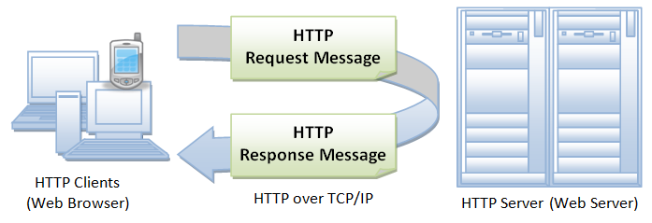
How HTTP Works?
Request: A client (typically a web browser) sends an HTTP request to the web server. This request includes details like the type of request (GET, POST, etc.) and the resource (URL) being requested.
Processing: The server processes the request, retrieves the requested resource (HTML file, image, etc.), and prepares a response.
Response: The server sends an HTTP response back to the client, typically containing the requested resource or an error message if the resource cannot be found.

Slide 4
HTTP Request Structure
An HTTP request is made up of several parts:
Request Line: Contains the HTTP method, the URL, and the HTTP version.
Example: GET /index.html HTTP/1.1
Headers: Contain metadata about the request, such as the type of content requested or user-agent (browser).
Example: User-Agent: Mozilla/5.0
Body (optional): Contains data sent with the request (e.g., form submissions).
Example:
GET /home HTTP/1.1
Host: www.example.com
User-Agent: Mozilla/5.0

Slide 5
HTTP Response Structure
The HTTP response sent from the server contains:
Status Line: Includes the HTTP version, status code, and a brief description of the status.
Example: HTTP/1.1 200 OK
Headers: Provide metadata about the response, such as content type, server information, or cookies.
Example: Content-Type: text/html
Body: The content of the response (HTML, images, JSON, etc.).
Example:
less
Copy code
HTTP/1.1 200 OK
Content-Type: text/html
Content-Length: 1234
<html>...</html>

Slide 6
HTTP Status Codes
HTTP status codes indicate the result of a client’s request. Some important status codes include:
200 OK: The request was successful.
404 Not Found: The requested resource could not be found on the server.
500 Internal Server Error: There was an error on the server.
301 Moved Permanently: The resource has been permanently moved to a new location.
403 Forbidden: The server understands the request but refuses to authorize it.

Slide 7
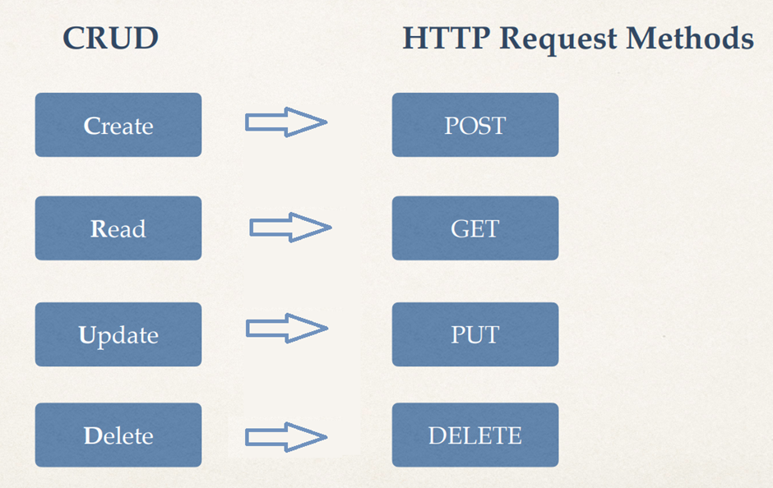
HTTP Methods
HTTP defines several methods for interacting with resources:
GET: Retrieve a resource (e.g., an HTML file, image).
POST: Send data to the server (e.g., form submission).
PUT: Update a resource on the server.
DELETE: Remove a resource from the server.
HEAD: Retrieve only the headers (no body content).
PATCH: Apply partial modifications to a resource.

Slide 8
Introduction to HTML
Definition: HTML is the standard language used to create and design web pages.
Purpose: It structures the content on a webpage, such as text, images, videos, and links.
Key Point: HTML uses elements (tags) to define the structure and content of a webpage.

Slide 9
Basic HTML Structure
A basic HTML document includes several essential elements:
<!DOCTYPE html>
<html lang="en">
<head>
<meta charset="UTF-8">
<meta name="viewport" content="width=device-width, initial-scale=1.0">
<title>My Web Page</title>
</head>
<body>
<h1>Welcome to My Web Page</h1>
<p>This is a paragraph of text.</p>
</body>
</html>
<!DOCTYPE html>: Declares the document type.
<html>: Root element of the document.
<head>: Contains metadata about the webpage (title, character encoding).

Slide 10
Key HTML Elements
Text Elements:
<h1> to <h6>: Headings (from largest to smallest).
<p>: Paragraph.
<a>: Anchor (for links).
<ul>: Unordered list.
<ol>: Ordered list.
<li>: List item.
Media Elements:
<img>: Embeds an image.
<audio>: Embeds an audio file.
<video>: Embeds a video file.
Form Elements:
<form>: Defines a form for user input.
<input>: Defines an input field.
<textarea>: Defines a text area.

Slide 11
Heading and paragraph
<!DOCTYPE html>
<html>
<body>
<h1>My First Heading</h1>
<h2>This is heading 2</h2>
<h3>This is heading 3</h3>
..
<h6>This is heading 6</h6>
<p>My first paragraph.</p>
</body>
</html>

Slide 12
Links and navigation - Anchor Tag
<!DOCTYPE html>
<html>
<body>
<h1>My First Heading</h1>
<a href="https://www.wolframalpha.com/">This is a link</a>
</body>
</html>
Relative vs. Absolute URLs:
Relative URL: Links to a resource within the same website (e.g., page2.html).
Absolute URL: Links to a resource on any website (e.g., https://www.example.com).

Slide 13
HTML Documents – image
<!DOCTYPE html>
<html>
<body>
<h1>My First Heading</h1>
<img src="sunflower.jpg" width="104" height="142">
</body>
</html>
Note: src also have relative and absolute url

Slide 14
HTML Document - Buttons
<!DOCTYPE html>
<html>
<body>
<h2>HTML Buttons</h2>
<p>HTML buttons are defined with the button tag:</p>
<button>Click me</button>
</body>
</html>

Slide 15


Slide 16
HTML Forms
Forms allow users to submit data to a server:
<input>: Defines an input field (e.g., text box, button).
<label>: Defines a label for input elements.
<select>: Defines a drop-down menu.
<textarea>: Defines a multi-line text input.
Example:
<div>
<label for="name">Name:</label>
<input type="text" id="name" name="name">
<input type="submit" value="Submit">
</div>

Slide 17
Types of Input
1. Text
Allows the user to enter a single line of plain text.
<input type="text" placeholder="Enter name">
2. Password
Hides the text.
<input type="password" placeholder="Password">
3. File
Let’s the user upload a file. A Filepicker is displayed.
<input type="file" accept="image/*">

Slide 18
Types of Input
1. Checkbox
Represents a binary choice (checked/unchecked).
<input type="checkbox" id="subscribe">
2. Radio
Allows selecting one option from a group of options. Multiple radio buttons that form part of the same group will have the same name value.
<input type="radio" name="gender" value="male"> <input type="radio" name="gender" value="female">
3. Date
Allows a user to select a date using a datepicker.
<input type="date">.
https://www.w3schools.com/html/html_form_input_types.asp

Slide 19
HTML Tables
HTML tables are used to display data in a grid format.
<table>: Defines the table.
<tr>: Table row.
<td>: Table data (cell).
<th>: Table header.
<table>
<tr>
<th>Name</th>
<th>Age</th>
</tr>
<tr>
<td>John</td>
<td>30</td>
</tr>
</table>

Slide 20
HTML Comment Tags
<!DOCTYPE html>
<html>
<body style="background-color : powderblue;">
<!-- Write your comments here -->
<h1 style="text-align:center;">Centered Heading</h1>
<p style="text-align:center;">Centered paragraph.</p>
</body>
</html>

Slide 21
HTML Document - list
Ordered List
<ol>
<li>Coffee</li>
<li>Tea</li>
<li>Milk</li>
</ol>
Unordered List
<ul>
<li>Coffee</li>
<li>Tea</li>
<li>Milk</li>
</ul>

Slide 22
HTML5 Features
HTML5 introduced semantic html elements:
<article>: Represents a self-contained piece of content.
<section>: Represents a section of a document.
<footer>: Represents defines a footer for a document or section.
<aside>: Represents defines some content aside from the content it is placed in.

Slide 23
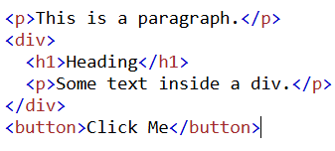
Enclosing Tags
These tags require both opening and closing tags.
They are used for elements that enclose content and can contain child elements.
Format: <tagName>content</tagName>

Slide 24

Self-closing Tags
These tags do not need a separate closing tag.
They are typically used for elements that cannot contain child elements.
Format: <tagName />

Slide 25
Block Level Elements
These elements take up the full width of their parent container and start on a new line. They stack vertically and usually occupy the entire available horizontal space.
Examples:
<div>
<p>
<h1>, <h2>, <h3>, etc.

Slide 26
Inline Elements
These elements only take up as much width as their content. They do not start on a new line and only occupy the space they need, staying within the flow of the content around them.
Examples:
<span>
<label>
<img>

Slide 27




--->
--->

Slide 28
Class Test
Create a an html document with title (in head tag) “Provinces and Cities of Pakistan.
For the visible part of the document (to be displayed in the browser’s viewport), set heading as “Provinces of Pakistan and Some of Their Cities”.
Now create an unordered list containing the names of any three provinces of Pakistan. Then, create three nested ordered lists within the unordered list, containing names of any two cities of each province.

Slide 29
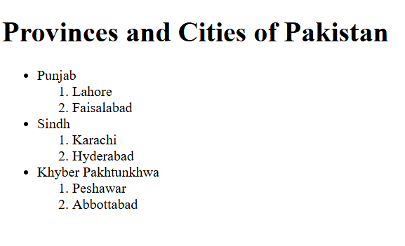

Slide 30
<!DOCTYPE html>
<html lang="en">
<head>
<meta charset="UTF-8">
<meta name="viewport" content="width=device-width, initial-scale=1.0">
<title>Provinces and Cities of Pakistan</title>
</head>
<body>
<h1>Provinces and Cities of Pakistan</h1>
<ul>
<li>
Punjab
<ol>
<li>Lahore</li>
<li>Faisalabad</li>
</ol>
</li>
<li>
Sindh
<ol>
<li>Karachi</li>
<li>Hyderabad</li>
</ol>
</li>
<li>
Khyber Pakhtunkhwa
<ol>
<li>Peshawar</li>
<li>Abbottabad</li>
</ol>
</li>
</ul>
</body>
</html>

